Slide 1
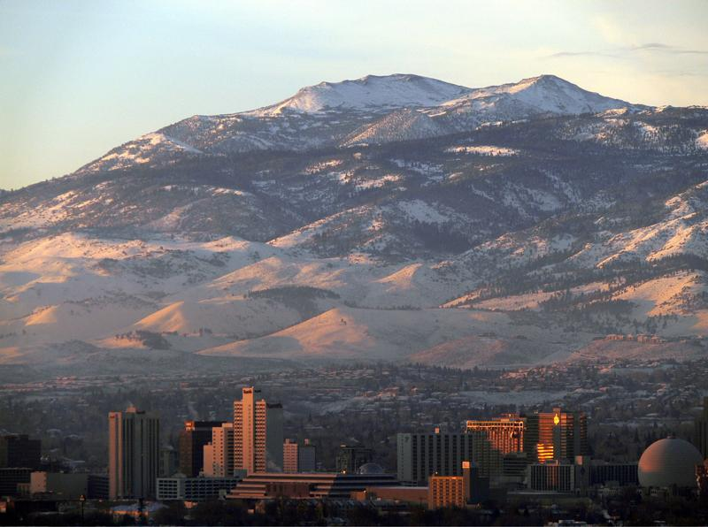

May 20, 2020
Finance Department
City of Reno
Deborah Lauchner, Finance Director

Slide 2
May 20, 2020 Agenda
City of Reno Strategic Plan & Guiding Principles
FY2020/2021 Budget Overview
General Fund Summary
General Government
  Special Revenue Funds
  Capital Project Funds
  Debt Service Funds
Proprietary Funds
Redevelopment Areas 1 & 2
2

Slide 3
City of Reno Strategic Plan for 2020-2025
Public Safety
Identify New Revenues
Homelessness
Fiscal Sustainability
Affordable Housing
Downtown Action Plan
Homelessness
Revitalization
Public Safety
Parks
Partnerships
Flood Mitigation
Development
3
Notes:
Manager budget was derived strategically from known Council Priorities

Slide 4
Budget Guiding Principles
Structural Budget Deficit Elimination - balanced budget approach
General Fund Reserves - maintain level of between 8.3% and 25%
Stabilization Fund - maintain to mitigate the effects of a natural disaster
Allocation of New Revenue Sources – 1) Stabilization, 2) OPEB, 3) W/C, 4) Capital, 5) Council priorities
Budget Forecasting – 5-year forecast
Commit to Maintaining Delivery of Core Services – prioritize expenditures based on core services
Commit to Improve Service Delivery and Reduce Duplication – efficiency improvements to eliminate service duplication
Use of One-Time Resources – one-time resources to one-time expenses
Establish Cost Recovery for Identified Programs and Services – 100% cost recovery
4

Slide 5
Budget Guiding Principles (continued)
Include Resources Required to Maintain and Operate Capital Improvements and New Programs – plan for ongoing operational and replacement expenses
Fully Fund Annual Contributions to OPEB Trust – fully fund annual contribution to OPEB trust
Public Works Capital Project Fund – capital infrastructure and maintenance plan
Essential Capital Assets – maintain inventory of capital assets
Year-end Fund Balance by Department – CM authorization for use of prior year savings
Maximizing Regional Revenues – advocate for regionally generated revenues for City needs
Future Planning –avoid balancing current year budget at expense of future budgets
Revenue Allocation – avoid targeting revenues for specific programs
5

Slide 6
FY2020/2021 Budget Overview

Slide 7
FY 20/21 Budget Overview
  Status Quo Budget
    Includes current staffing levels
    Includes CBA factors, PERS, health benefits
    Services and Supplies
      Increases for contract services
  Additional funding requests
    Clean and Safe Team
  Fully fund annual contribution to OPEB trust
  Increase annual funding to Workers Comp Fund 10%, Risk Fund 10%, & Fleet Fund 20%
  Maintain a General Fund reserve level of between 8.3% and 16%
7

Slide 8
FY 20/21 Budget Overview (continued)
  Several reasons for status quo budget:
    Insufficient data to make reasonable revenue forecasts at this time to determine the depth and severity of the economic impact
    Allows maximum budget flexibility as the extent of the downturn becomes clear
    Provides a baseline to measure the extent of the financial impact from COVID-19
    Consistent with other local agencies
8

Slide 9
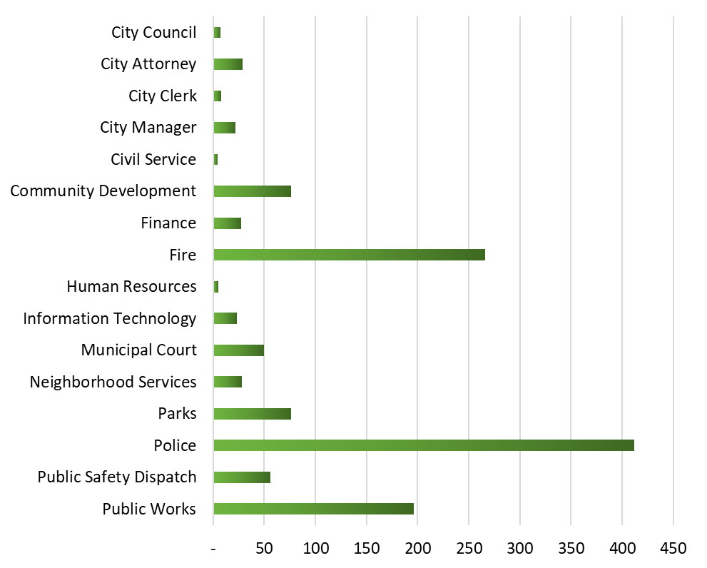
FY20/21 Summary of FTE’s by Department
9

Slide 10
General Fund Summary

Slide 11
Property Tax History

Slide 12
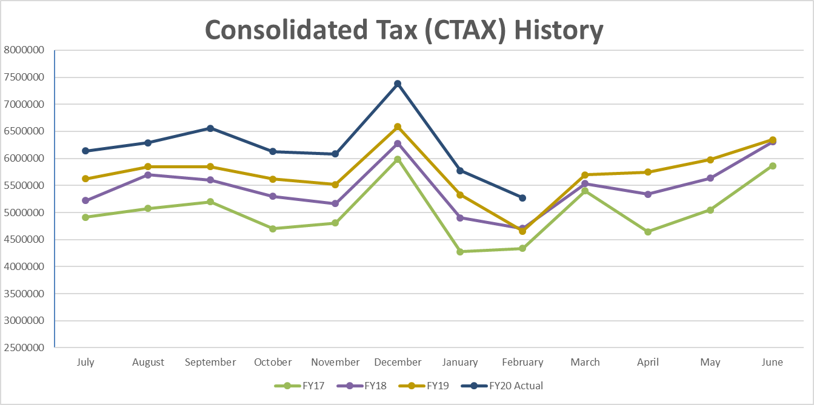
CTAX History
12

Slide 13
Property Tax & CTAX History

Slide 14
FY 20/21 General Fund Revenues by Category
6%
35%
$223 Million
10%
1%
14

Slide 15
FY20/21 General Fund Revenues and Other Resources
15

Slide 16
FY20/21 General Fund Revenues
16

Slide 17
FY20/21 General Fund Expenditures & Other Uses
17

Slide 18
FY 20/21 General Fund Expenditures by Category
Total General Fund Expenditures FY2020/2021
$224M
18
Notes:
81% Salaries/Benefits
19 % S&S /other

Slide 19
FY 20/21 General Fund Dept Expenditures by Function
Total General Fund Expenditures FY2020/2021
$224M
19
Notes:
Well over half of general fund budget is dedicated to public safety

Slide 20
FY20/21 General Fund Expenses & Uses by Dept.
20

Slide 21
FY20/21 General Fund Expenses & Uses by Dept.(Cont.)
21

Slide 22
FY20/21 General Fund Summary
22

Slide 23
General Fund Balance History
Projected

Slide 24
General Government – Special Revenue Funds

Slide 25
FY20/21 General Government – Special Revenue Funds
25

Slide 26
FY20/21 Capital Outlay – Special Revenue Funds
26

Slide 27
General Government – Capital Project Funds

Slide 28
FY20/21 General Government – Capital Project Funds
28

Slide 29
FY20/21 Capital Outlay – Capital Project Funds
29

Slide 30
General Government – Debt Funds

Slide 31
FY20/21 General Government – Debt Funds
31

Slide 32
Proprietary Funds

Slide 33
FY20/21 Proprietary Funds
33

Slide 34
FY20/21 Capital Outlay – Proprietary Funds
34

Slide 35
Redevelopment Areas 1 & 2

Slide 36
Redevelopment Agency #1
RDA #1 GENERAL FUND
Downtown area and parking garage on Sierra Street including ground floor of retail space. The West Street Market lease ended 3/31/18.
Garage is managed by Colliers who is responsible for renting the retail space, collecting the rent, and paying for upkeep.
Parking garage revenues are pledged to debt so any excess revenue over expenditures must be transferred to the debt fund.
There are currently not any property tax revenues available for the general fund. A fixed amount of MV privilege tax was given to RDA #1 when it was established and will continue at the same amount until the agency is closed.
Miscellaneous expenses can include extraordinary repairs and/or maintenance on the garage.
RDA #1 DEBT FUND
Includes bonds issued to build various projects.
Settlement agreement that ensured enough property taxes to make the bond payments ended 06/30/18.
Reserves are being depleted to make current bond payments. Discussions are underway regarding options for the future.
36

Slide 37
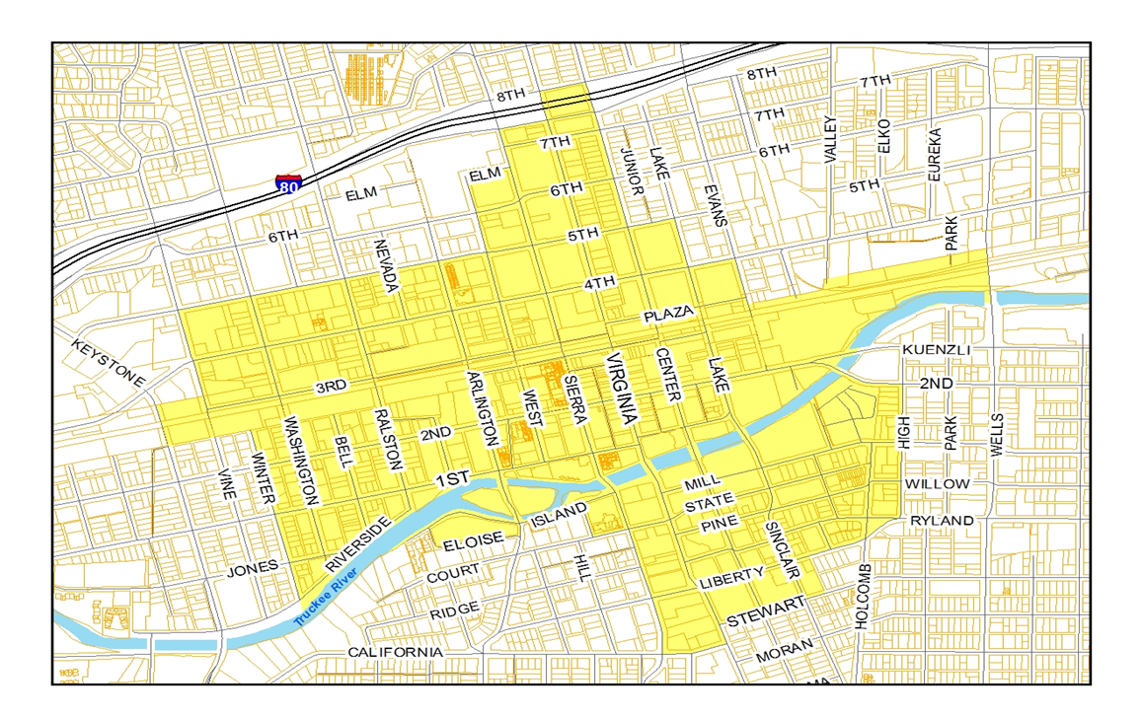
Redevelopment Agency #1
37

Slide 38
FY20/21 Redevelopment Agency #1 General Fund
38
Notes:
Funds 80000

Slide 39
FY20/21 Redevelopment Agency #1 Debt Fund
Settlement agreement ended 6/30/2018
39
Notes:
Funds 80000

Slide 40
Redevelopment Agency #2
RDA #2 GENERAL FUND
Seven different areas including Cabela’s, Baseball District, and Park Lane Mall area.
Property tax revenues have increased and fully cover the payment of the baseball agreement without any supplement from the City’s General Fund in FY20/21.
Baseball agreement is paid from outside services account. The baseball agreement is payment for the construction of the stadium and retail development.
RDA #2 DEBT FUND
Includes small bond for improvements at Cabela’s
Fire station loan complete (6/30/18)
40

Slide 41
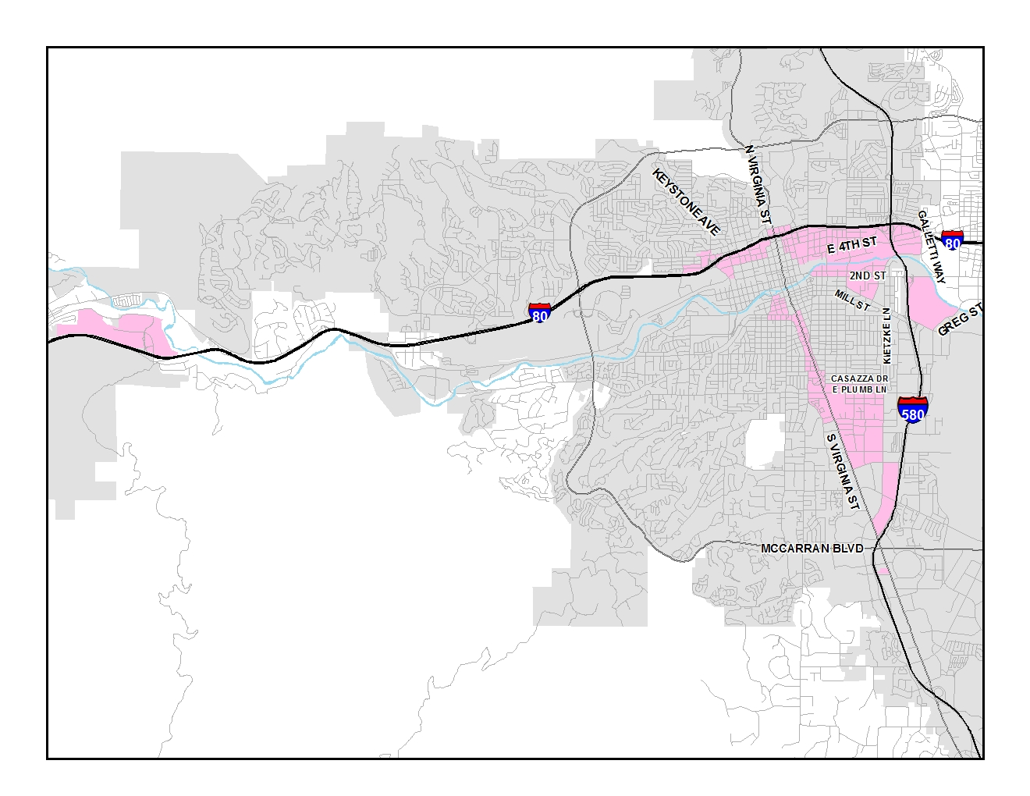
Redevelopment Agency #2
41

Slide 42
FY20/21 Redevelopment Agency #2 General Fund
42
Notes:
Funds 80000

Slide 43
FY20/21 Redevelopment Agency #2 Debt Fund
43
Notes:
Funds 80000

Slide 44
Questions?

